Slide 1
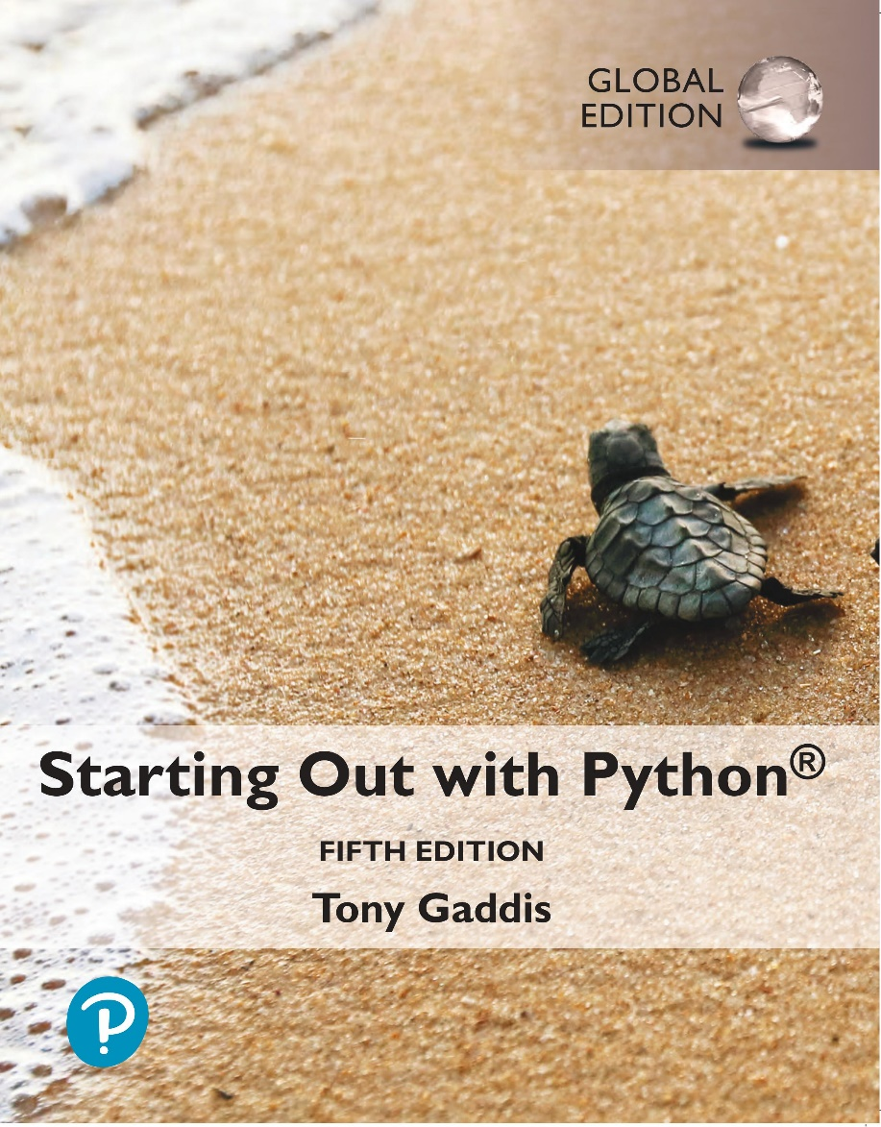
Starting out with Python
Fifth Edition, Global Edition
Chapter 3
Decision Structures and Boolean Logic
Copyright © 2022 Pearson Education, Ltd. All Rights Reserved.

Slide 2
Topics
The if Statement
The if-else Statement
Comparing Strings
Logical Operators
Boolean Variables

Slide 3
The if Statement (1 of 5)
Control structure: logical design that controls order in which set of statements execute
Sequence structure: set of statements that execute in the order they appear
Decision structure: specific action(s) performed only if a condition exists
Also known as selection structure

Slide 4
The if Statement (2 of 5)
In flowchart, diamond represents true/false condition that must be tested
Actions can be conditionally executed
Performed only when a condition is true
Single alternative decision structure: provides only one alternative path of execution
If condition is not true, exit the structure

Slide 5
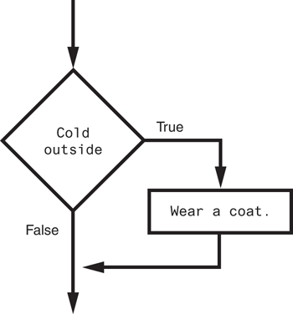
The if Statement (3 of 5)
Figure 3-1 A simple decision structure

Slide 6
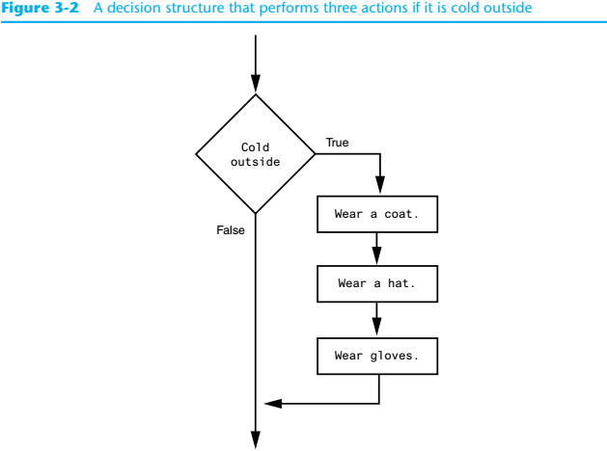
The if Statement (4 of 5)
Figure 3-2 A decision structure that performs three actions i it is cold outside

Slide 7
The if Statement (5 of 5)
Python syntax:
if condition:
Statement
Statement
First line known as the if clause
Includes the keyword if followed by condition
The condition can be true or false
When the if statement executes, the condition is tested, and if it is true the block statements are executed. otherwise, block statements are skipped

Slide 8
Boolean Expressions and Relational Operators (1 of 6)
Boolean expression: expression tested by if statement to determine if it is true or false
Example: a > b
true if a is greater than b; false otherwise
Relational operator: determines whether a specific relationship exists between two values
Example: greater than (>)

Slide 9
Boolean Expressions and Relational Operators (2 of 6)
>= and <= operators test more than one relationship
It is enough for one of the relationships to exist for the expression to be true
== operator determines whether the two operands are equal to one another
Do not confuse with assignment operator (=)
!= operator determines whether the two operands are not equal

Slide 10
Boolean Expressions and Relational Operators (3 of 6)
Table 3-2 Boolean expressions using relational operators
Expression | Meaning
x > y | Is x greater than y?
x < y | Is x less than y?
x >= y | Is x greater than or equal to y?
x <= y | Is x less than or equal to y?
x == y | Is x equal to y?
x != y | Is x not equal to y?

Slide 11
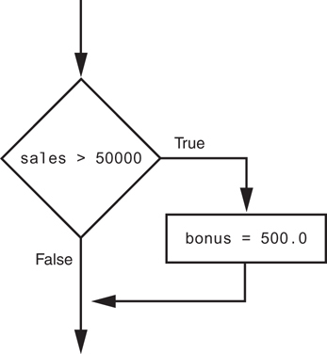
Boolean Expressions and Relational Operators (4 of 6)
Using a Boolean expression with the > relational operator
Figure 3-3 Example decision structure

Slide 12
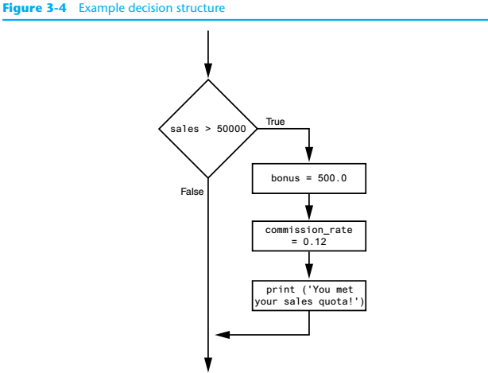
Boolean Expressions and Relational Operators (5 of 6)
Figure 3-4 Example decision structure

Slide 13
Boolean Expressions and Relational Operators (6 of 6)
Any relational operator can be used in a decision block
Example: if balance == 0
Example: if payment != balance
It is possible to have a block inside another block
Example: if statement inside a function
Statements in inner block must be indented with respect to the outer block

Slide 14
The if-else Statement (1 of 3)
Dual alternative decision structure: two possible paths of execution
One is taken if the condition is true, and the other if the condition is false
Syntax: if condition:
statements
else:
other statements
if clause and else clause must be aligned
Statements must be consistently indented

Slide 15
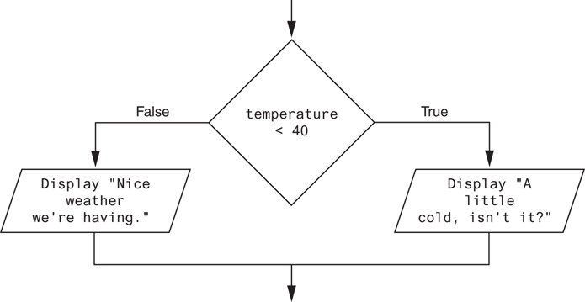
The if-else Statement (2 of 3)
Figure 3-5 A dual alternative decision structure

Slide 16
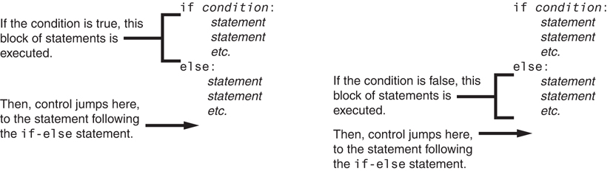
The if-else Statement (3 of 3)
Figure 3-6 Conditional execution in an if-else statement

Slide 17
Örnek
Soru: Girilen 2 farklı sayının büyük olanını bulan algoritma:

Slide 18
Örnek
Soru: Girilen 2 farklı sayıyı küçükten büyüğe sıralı olarak ekrana yazdıran algoritma:

Slide 19
Örnek
Soru: Girilen bir sayının tek/çift olduğunu bulan algoritma:

Slide 20
Comparing Strings (1 of 2)
Strings can be compared using the == and != operators
String comparisons are case sensitive
Strings can be compared using >, <, >=, and <=
Compared character by character based on the ASCII values for each character
If shorter word is substring of longer word, longer word is greater than shorter word

Slide 21
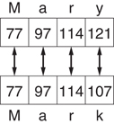
Comparing Strings (2 of 2)
Figure 3-9 Comparing each character in a string

Slide 22
Logical Operators
Logical operators: operators that can be used to create complex Boolean expressions
and operator and or operator: binary operators, connect two Boolean expressions into a compound Boolean expression
not operator: unary operator, reverses the truth of its Boolean operand

Slide 23
The and Operator
Takes two Boolean expressions as operands
Creates compound Boolean expression that is true only when both sub expressions are true
Can be used to simplify nested decision structures
Truth table for the and operator
Value of the Expression | Expression
false | false and false
false | false and true
false | true and false
true | true and true

Slide 24
The or Operator
Takes two Boolean expressions as operands
Creates compound Boolean expression that is true when either of the sub expressions is true
Can be used to simplify nested decision structures
Truth table for the or operator
Value of the Expression | Expression
false | false and false
true | false and true
true | true and false
true | true and true

Slide 25
Short-Circuit Evaluation
Short circuit evaluation: deciding the value of a compound Boolean expression after evaluating only one sub expression
Performed by the or and and operators
For or operator: If left operand is true, compound expression is true. Otherwise, evaluate right operand
For and operator: If left operand is false, compound expression is false. Otherwise, evaluate right operand

Slide 26
The not Operator
Takes one Boolean expressions as operand and reverses its logical value
Sometimes it may be necessary to place parentheses around an expression to clarify to what you are applying the not operator
Truth table for the not operator
Value of the Expression | Expression
false | true
true | false

Slide 27
Örnek
Soru: Boy barajının 175cm, kilo barajının 75kg olduğu bir askeri okula giriş sınavında adayın kazanıp kazanamadığını bulan algoritma:

Slide 28
Örnek
Soru: Bir dersi başarmak için final sınavı ve yılsonu notunun en az 60 olması gerekiyor (yılsonu notu, iki arasınavın ortalamasının %40’ı ile finalin %60’ı toplanarak bulunuyor), öğrencinin dersten geçip kaldığını bulan algoritma:

Slide 29
Checking Numeric Ranges with Logical Operators
To determine whether a numeric value is within a specific range of values, use and
Example: x >= 10 and x <= 20
To determine whether a numeric value is outside of a specific range of values, use or
Example: x < 10 or x > 20

Slide 30
Örnek
Soru: Girilen bir karakterin İngilizce’de yer alan bir küçük/büyük harf olup olmadığını bulan algoritma:

Slide 31
Örnek
Soru: Cinsiyetin belirtilmesi için girilen karakterin doğru (e/E/k/K) olup olmadığını bulan algoritma:

Slide 32
Boolean Variables (1 of 2)
Boolean variable: references one of two values, True or False
Represented by bool data type
Commonly used as flags
Flag: variable that signals when some condition exists in a program
Flag set to False → condition does not exist
Flag set to True → condition exists

Slide 33



Boolean Variables (2 of 2)

Slide 34
Summary
This chapter covered:
Decision structures, including:
Single alternative decision structures
Dual alternative decision structures
Relational operators and logical operators as used in creating Boolean expressions
String comparison as used in creating Boolean expressions
Boolean variables

